Slide 1

Mini Project Seminar on Pizza Ordering Application for Android

Slide 2

Geethanjali College Of Engineering and Technology
Cheeryal( V), Keesara ( M), Ranga Reddy District.
Internal Guide
Mr. P.SRINIVAS
Associate Professor
Department of Computer Science and Engineering
Project Team Members
D. Ravi Krishna 08R11A0512
K. Vrushank Reddy 08R11A0519
K. Ghanashyam. Pai 08R11A0517
B.Kranthi Kumar 08R11A0508

Slide 3
Introduction
Android is a software stack for mobile devices that includes an operating system, middleware and key applications.
The Android SDK provides the tools and APIs necessary to begin developing applications that run on Android-powered devices.

Slide 4
Purpose
This application has been developed for Android users to
- Order a Pizza.
- Search for Pizza shops available in a certain area.
- View their Menu.

Slide 5
Existing System
Customers need to personally go to the Pizza shop, check their menu, place an order and pay the bill upon receiving their pizza.
Lot of time is wasted in this process.
Proposed System
The user will be presented with an integrated application wherein he can find the list of pizza shops available in an area, view their menu, place an order and pay the bill online, without having to personally visit the shop.
The order can be collected based on the token number provided.

Slide 6
Scope
The scope of the project is to provide a Pizza ordering Service using an Android device. The application shows the list of different pizza shops available at a certain place, the list of pizzas available and also provides an option to buy.

Slide 7
Requirements Specification
Functional Requirements
Non-Functional Requirements
Software Requirements
Core Java
Android SDK
OS 1.1, 1.5, 1.6, 2.0
Eclipse Galileo
SQLite
Hardware Requirements
Processor : Pentium IV 1Ghz
Hard disk : 80GB
RAM : 1GB

Slide 8
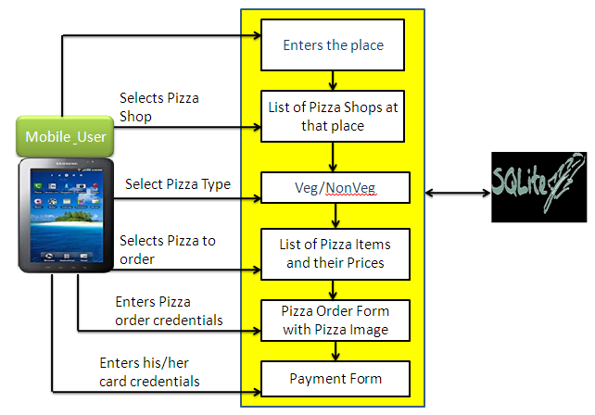
System Architecture
The project “Pizza Order Application” is an Android application which has a three-tier architecture.

Slide 9
Modules
Module 1: The user is provided with a list of pizza shops available in a certain area as per his request. Upon selection, the user is given a choice to view either the Veg or Non-Veg menu.
Module 2: The user is provided with a list of Pizzas along with their price as per the Veg or Non-Veg option selected. The user can also place an order and collect it based on the token number provided.
Module 3: The database tables required for the project are created.

Slide 10
UML Diagrams
Class Diagram:

Slide 11
UML Diagrams
Usecase Diagram:

Slide 12
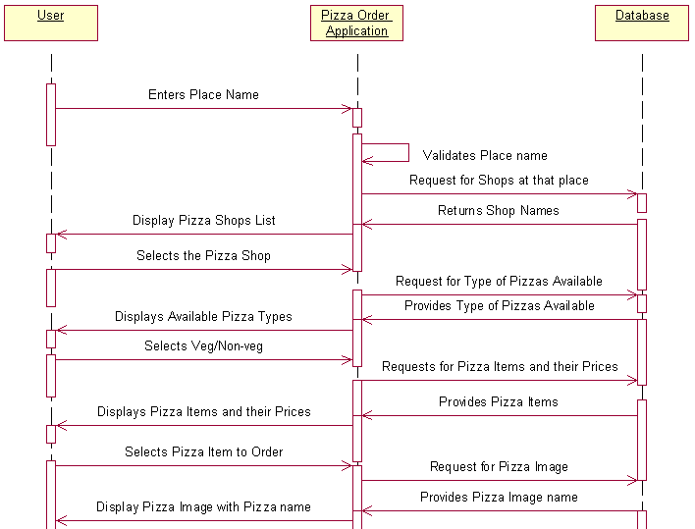
UML Diagrams
Sequence Diagram:

Slide 13
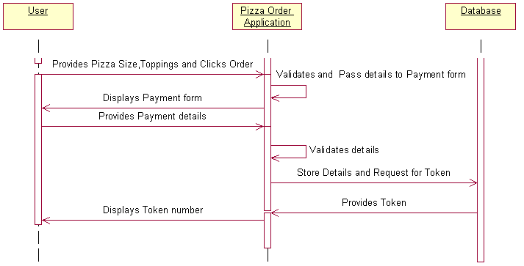

Slide 14
UML Diagrams
Collaboration Diagram:

Slide 15
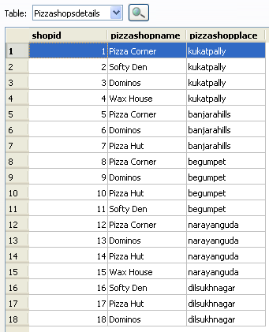
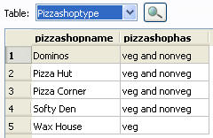
Database Tables
Pizza Shop details Pizza Shop type

Slide 16
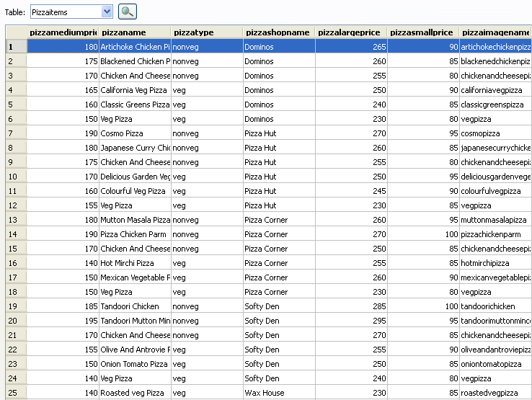
Database Tables
Pizza Items

Slide 17

Database Tables
Pizza Order

Slide 18
Technologies/Platforms Used
Android
Android is Google's operating system for mobile devices. It allows developers to write managed code in the Java language, controlling the device via Google-developed Java libraries. The Android operating system software stack consists of Java applications running on a Java based object oriented application framework on top of Java core libraries running on a Dalvik virtual machine featuring JIT compilation.
Android SDK
The Android SDK includes a comprehensive set of development tools like a debugger , libraries, a handset emulator , documentation, sample code, and tutorials.

Slide 19
Technologies/Platforms Used
Dalvik Virtual Machine
Dalvik is the virtual machine on Android mobile devices. It runs applications which have been converted into a compact Dalvik Executable (.dex) format suitable for systems that are constrained in terms of memory and processor speed.
SQLite

Slide 20
Integration and Testing
Integration
Integration is all about combining the individual parts of the system and making the system into a single unit. Here in this “Pizza Order Application” we are combining the modules i.e., User interface with the database.
Testing
1. Compilation Test: Stress testing is done early on, because it gives us time to fix some of the unexpected deadlocks and stability problems that only occur when components are exposed to very high transaction volumes.
2. Execution Test: The program is successfully loaded and executed with no execution errors. The complete performance of the project “Pizza Order Application” is good.

Slide 21
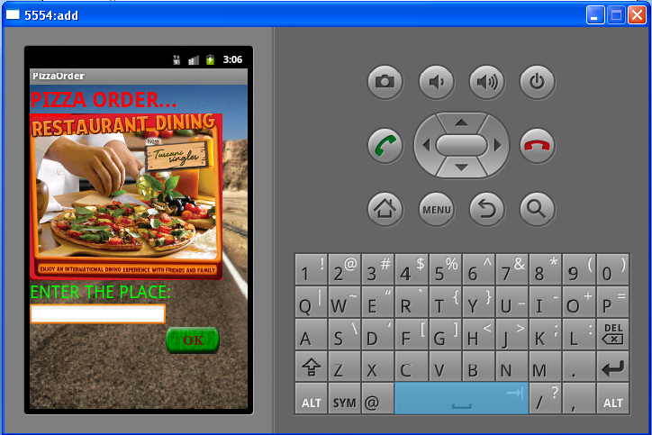
Output Screens
Home Screen

Slide 22
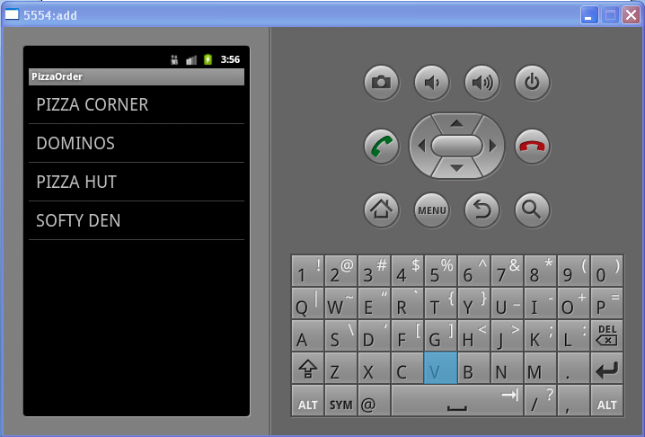
Output Screens
List of Pizza Shops Screen

Slide 23
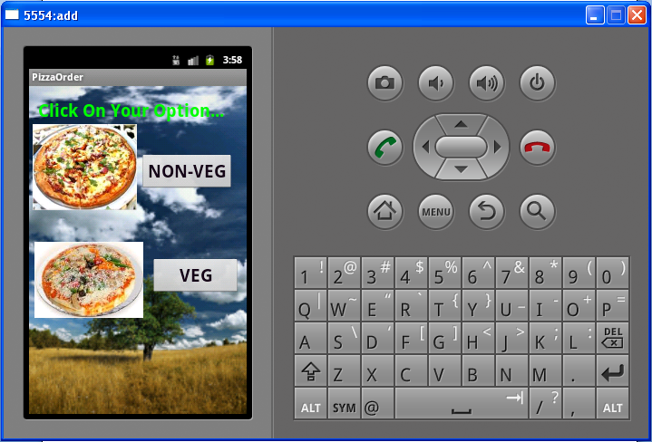
Output Screens
Pizza Types Screen

Slide 24
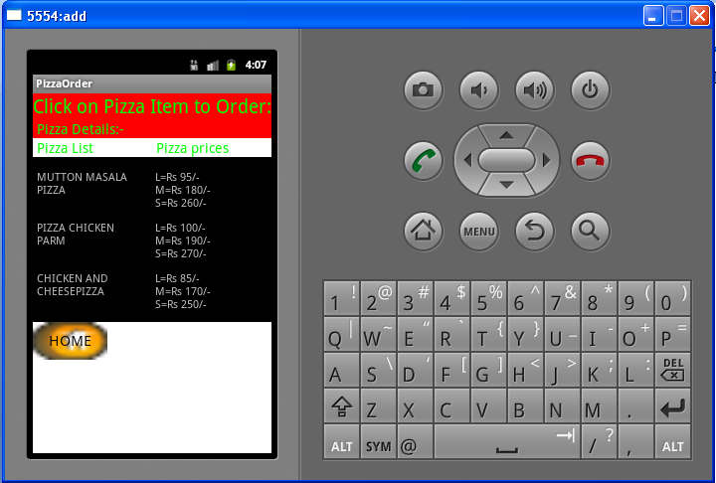
Output Screens
List of pizzas and their price Screen

Slide 25
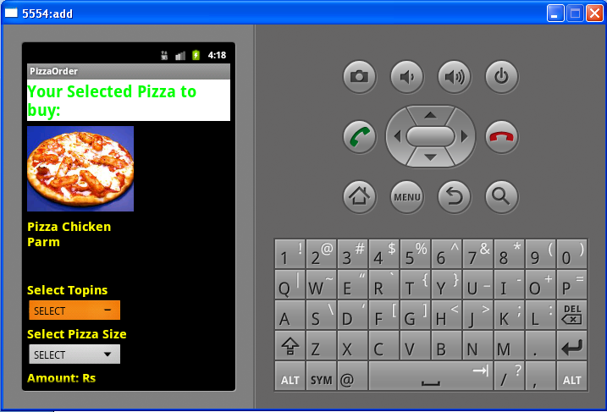
Output Screens
Pizza Order Screen

Slide 26
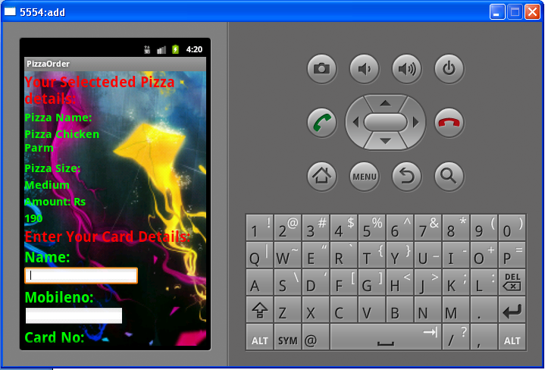
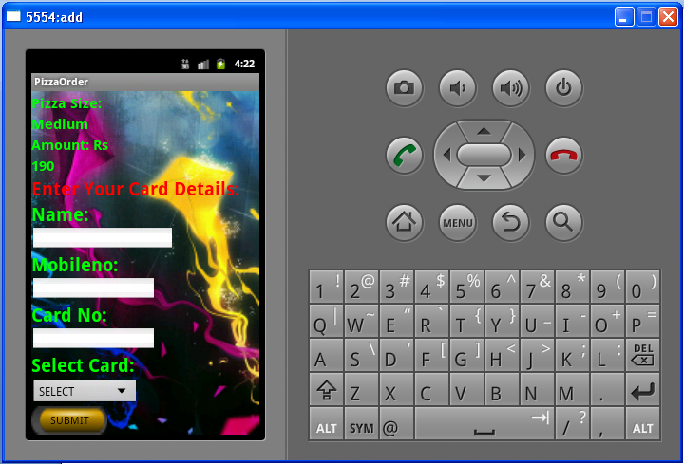
Output Screens
Payment Screen

Slide 27
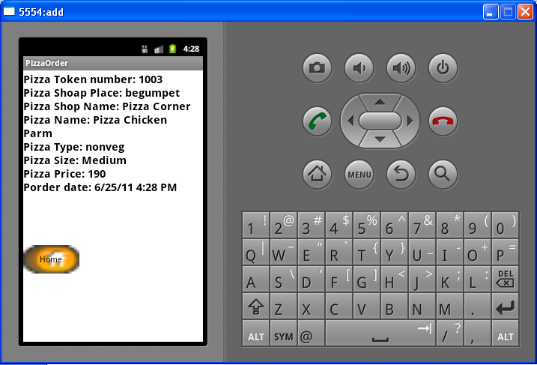
Output Screens
Order Details Screen

Slide 28
Conclusion
The “Pizza Order Application” for android helps a user to order a pizza from a stand alone place.
Before placing an order the user can view the available pizza shops at any place, the list of pizzas with their price, order a pizza after seeing its image and pay the bill using a card.
Benefits
Serves the users with all the requirements that can be easily accessible in a mobile
High graphical user interface

Slide 29
References
The Unified Modeling Language Users guide By Grady Booch
Software Engineering, A practitioners approach By Roger S Pressman
Software Project Management By Walker Royce
The applicable IEEE standards as published in ‘IEEE standards collection, for the preparation of SRS’.
Backup policy, Naming Conventions as per Teleparadigm Conventions
Android™ 2Application Development by Reto Meier
Hello, Android: Introducing Google's Mobile Development Platform by Ed Burnette.
http://developer.android.com/index.html
http://www.androidsnippets.com/

